Slide 1

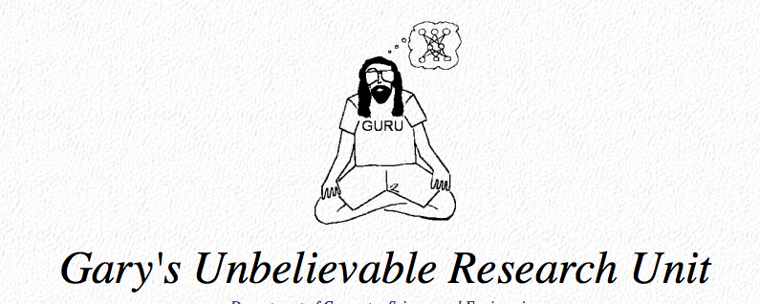

Using Deep Siamese Neural Networks to Speed Up Natural Products Research
Garrison W. Cottrell
CSE Department
Gary’s Unbelievable Research Unit (GURU)
UC San Diego

Slide 2
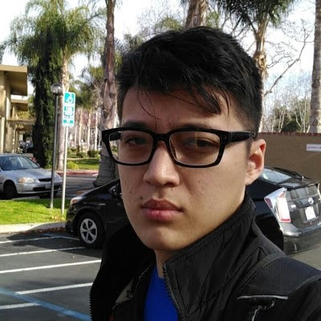
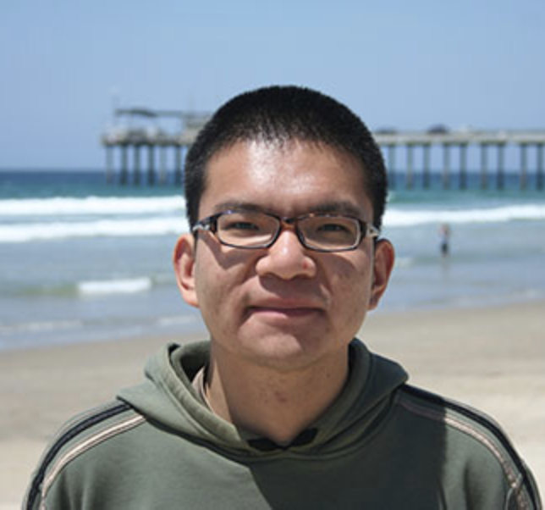
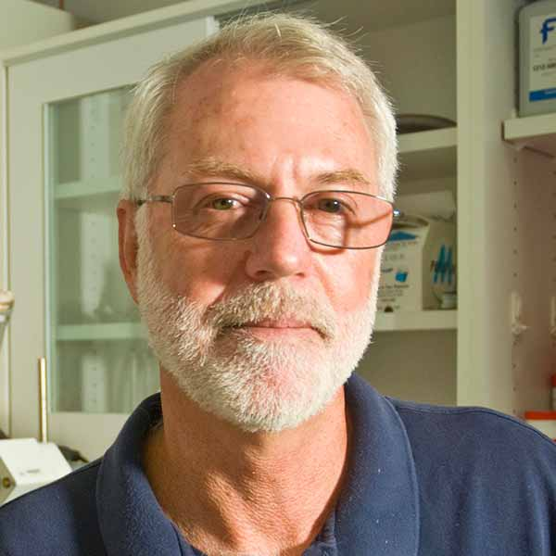
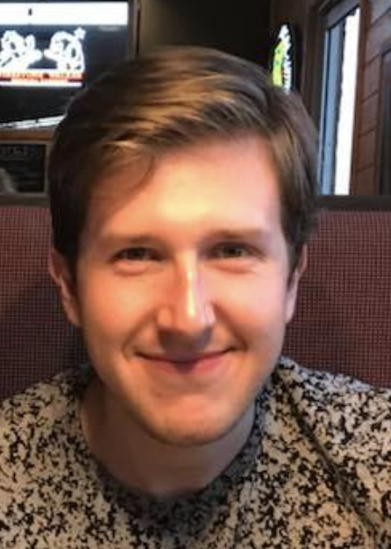
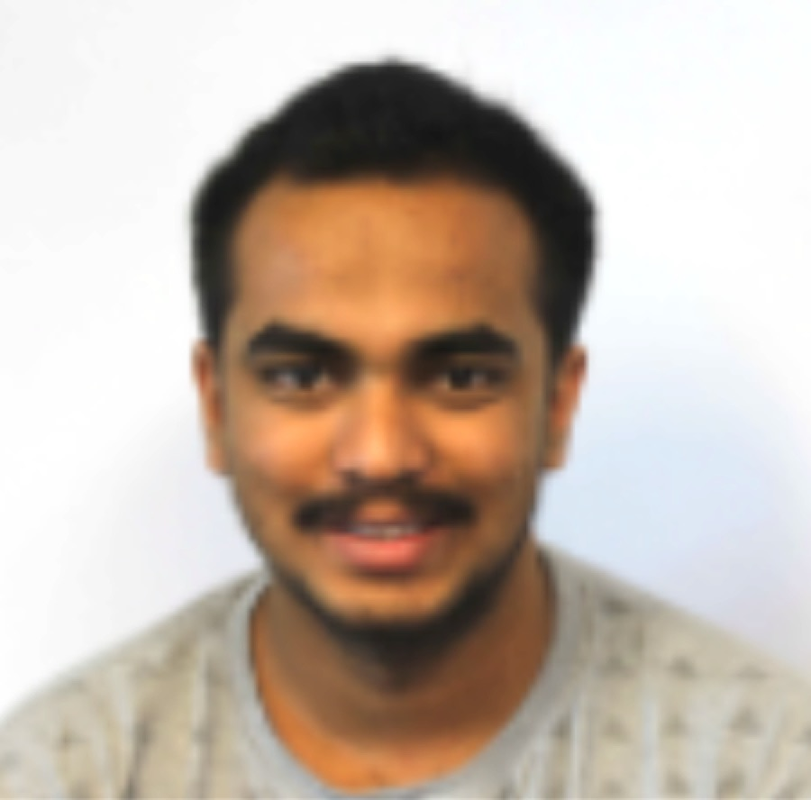
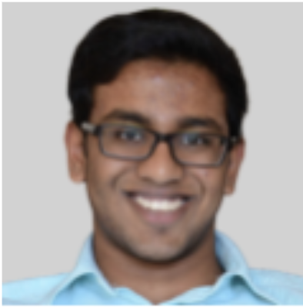
Collaborators
Yerlan Idelbayev
UC Merced
Chen Zhang
Scripps Instution
of Oceanography
Bill Gerwick
Scripps Instution
of Oceanography
Yash_Nannapaneni
UCSD
Poornav Sargur Purushothama
UCSD
Nick Roberts, UCSD

Slide 3
Outline
Natural products research
What is it
Why is it important
Deep Siamese Convolutional Networks
What are they
Why are they cool
SMART
Methods
Results

Slide 4
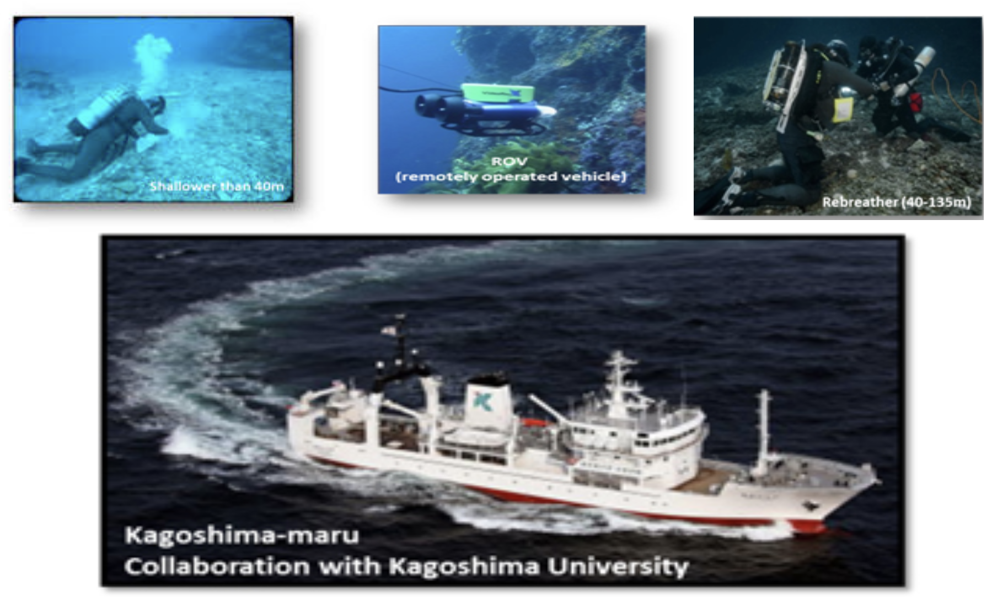
Natural Products Research
50% the approved drugs during the last 30 years are derived from natural products (Newman and Cragg 2012)

Slide 5
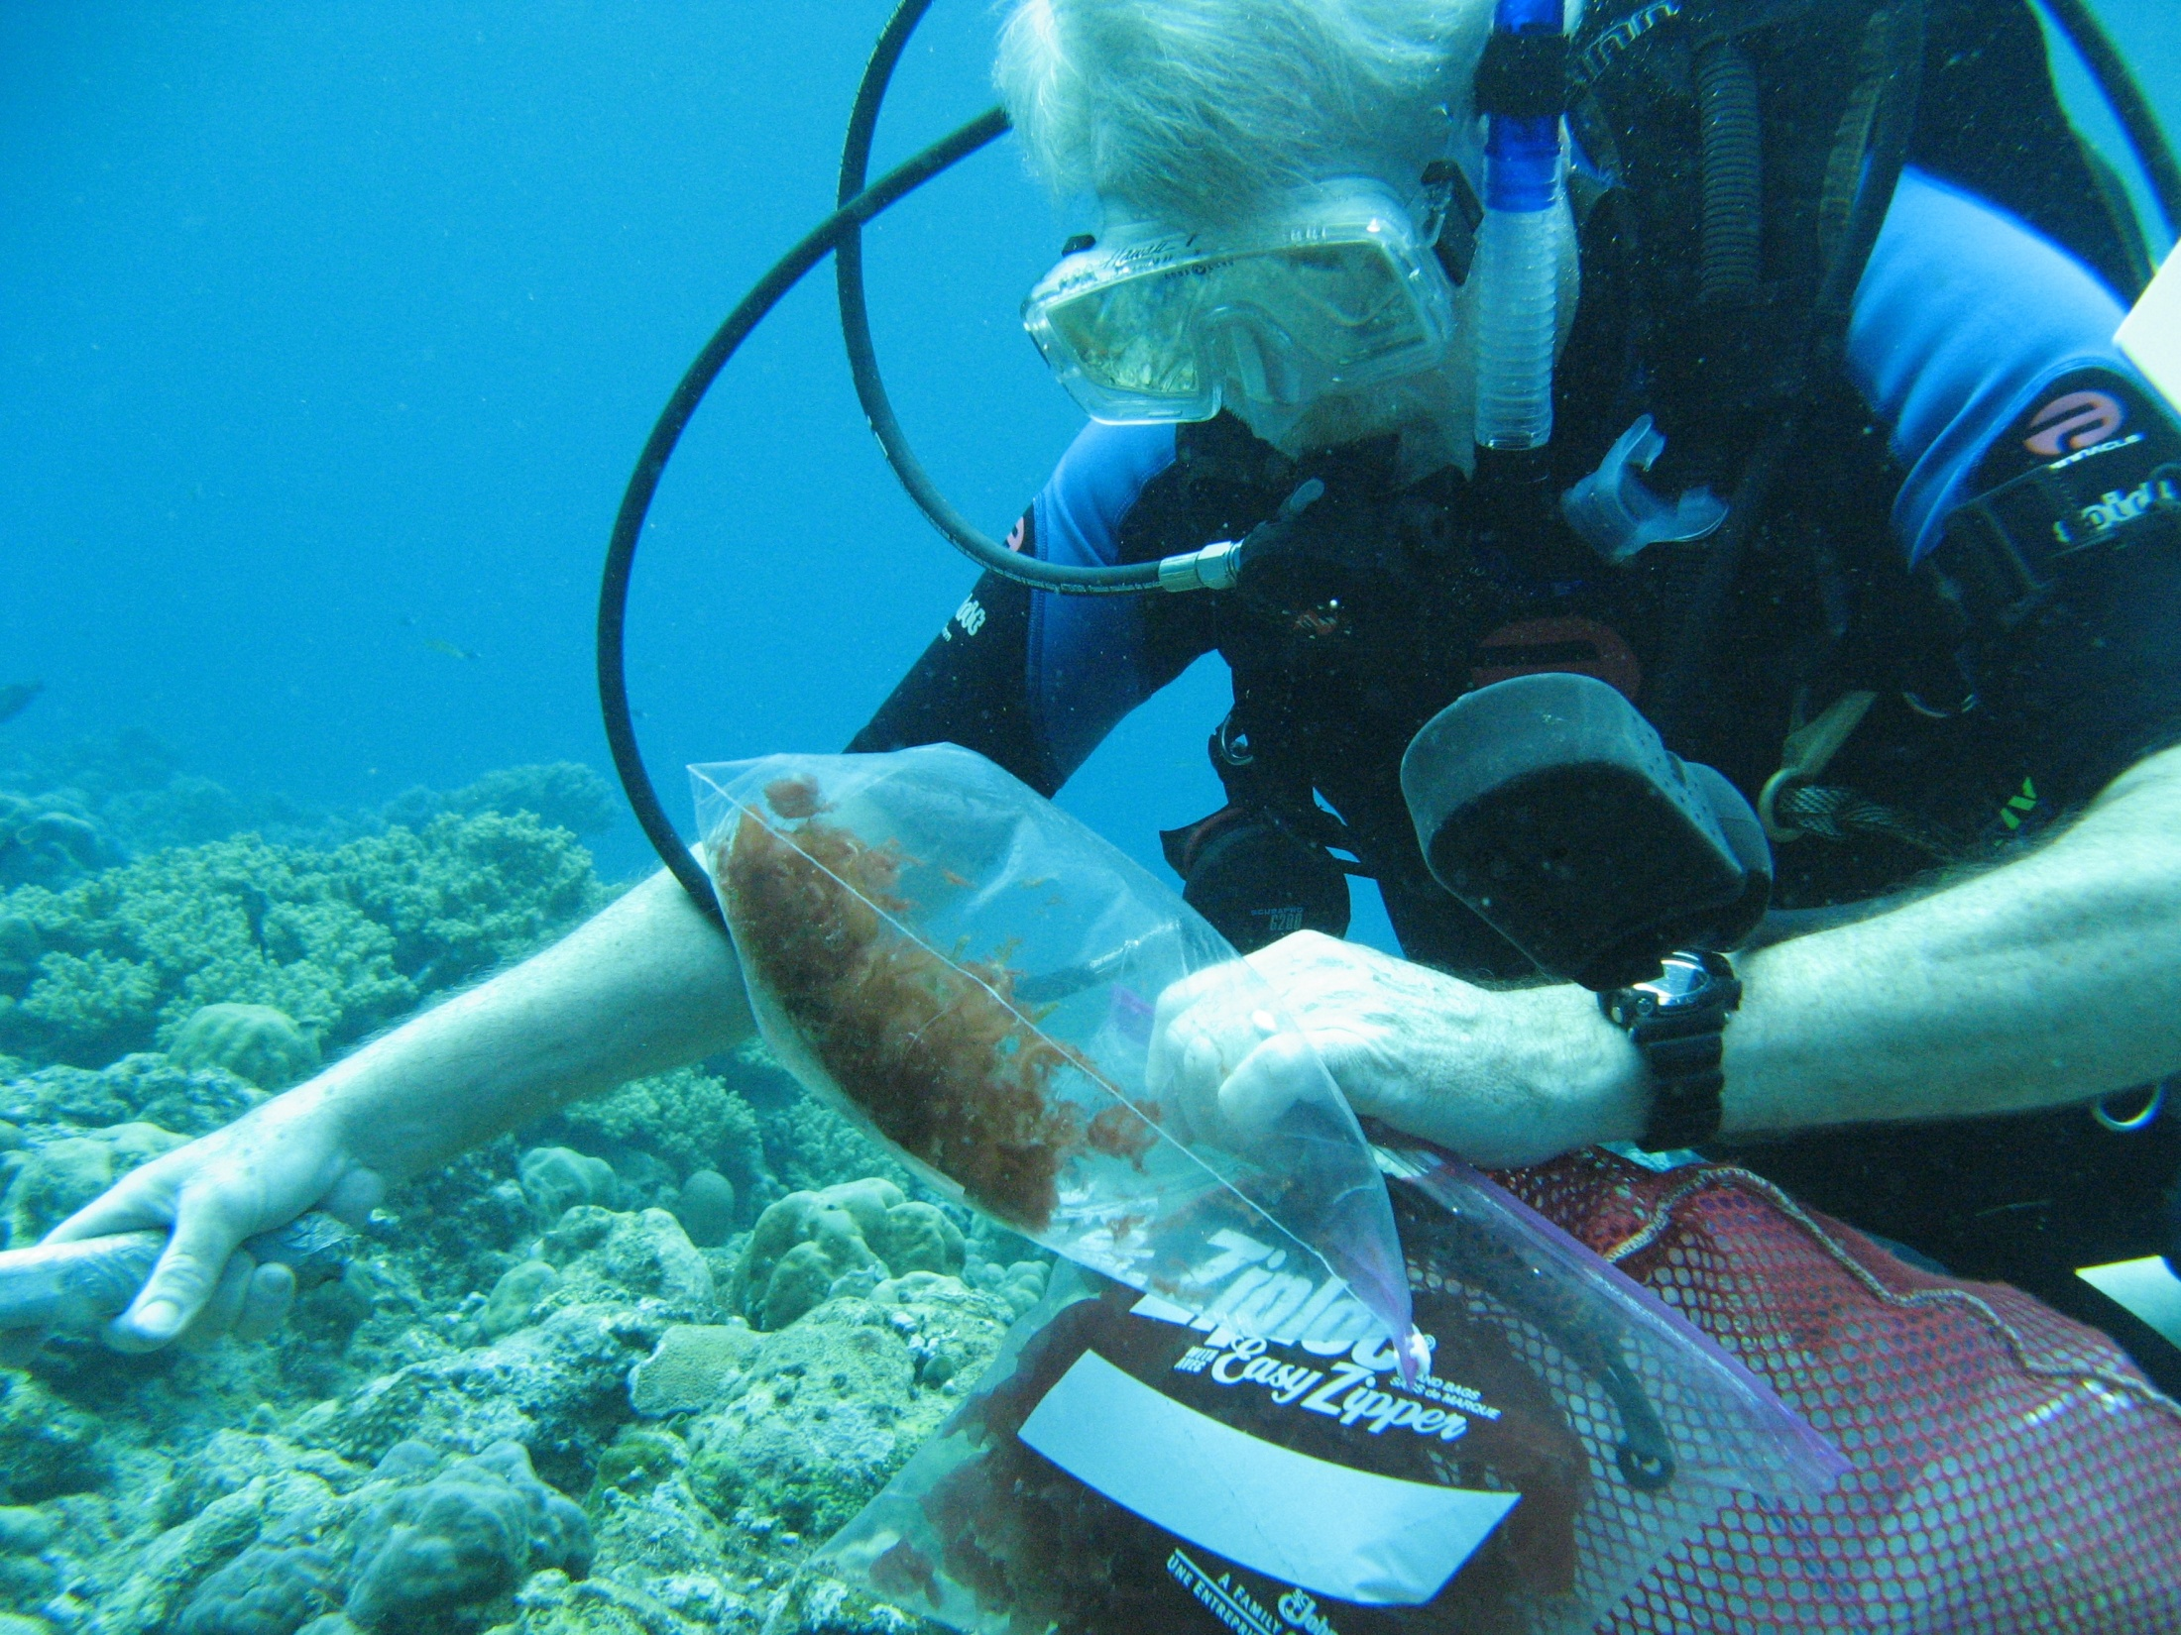
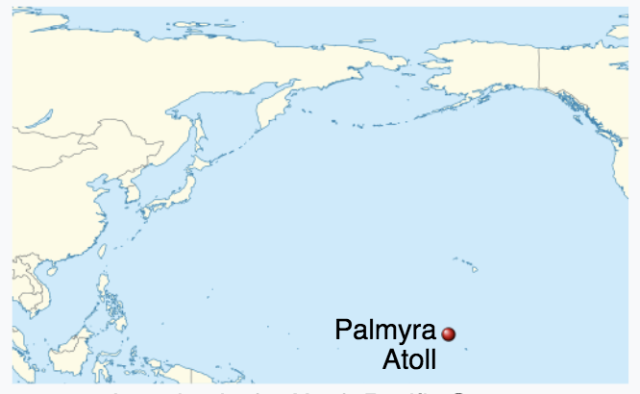
Natural Products Research
Here’s Bill himself collecting samples in the Palmyra Atoll
Bill Gerwick
Scripps Instution
of Oceanography

Slide 6
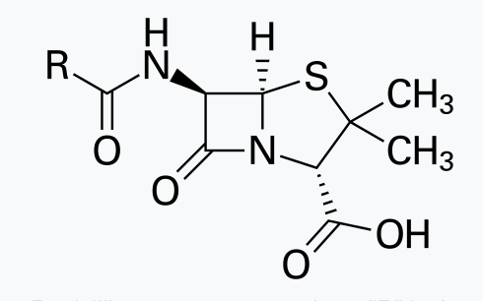
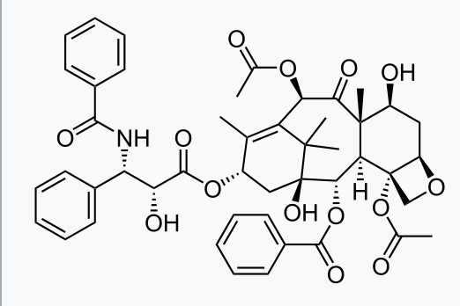
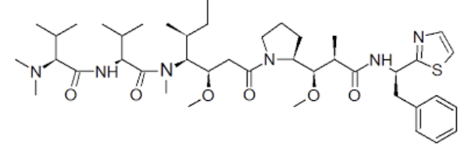
Natural Products Research
50% the approved drugs during the last 30 years are derived from natural products (Newman and Cragg 2012)
Penicillin (1928)
Taxol (1971) an anti-cancer agent derived from Yew tree bark
Dolastatin 10 (2001) another anti-cancer agent derived from from a sea hare that feeds on tropical cyanobacteria in the Indian Ocean, and later traced back to the cyanobacterium itself.

Slide 7
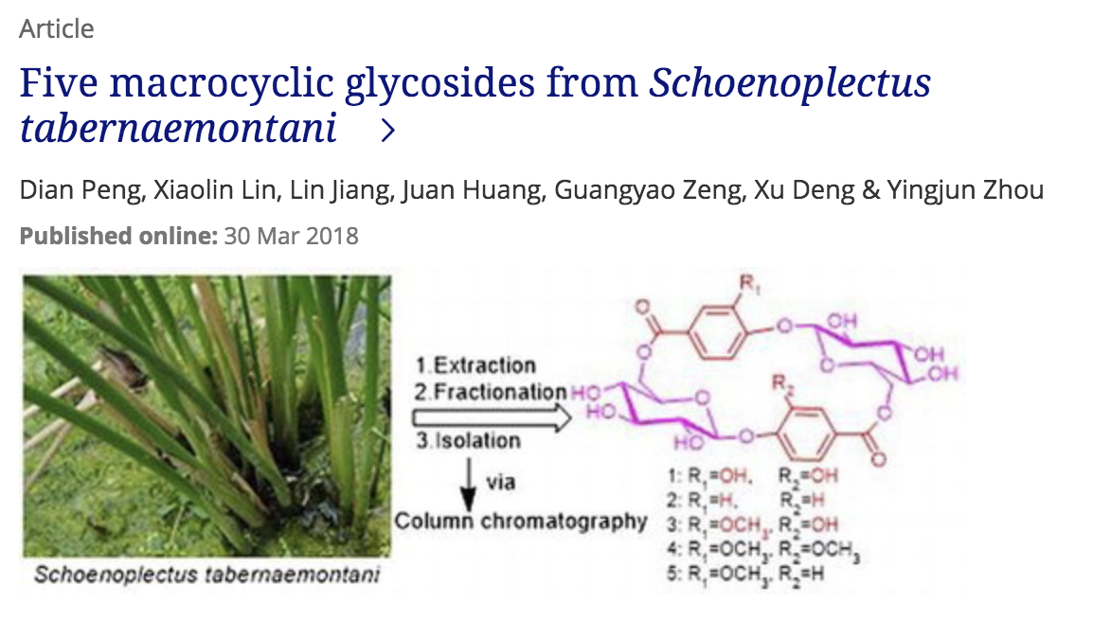
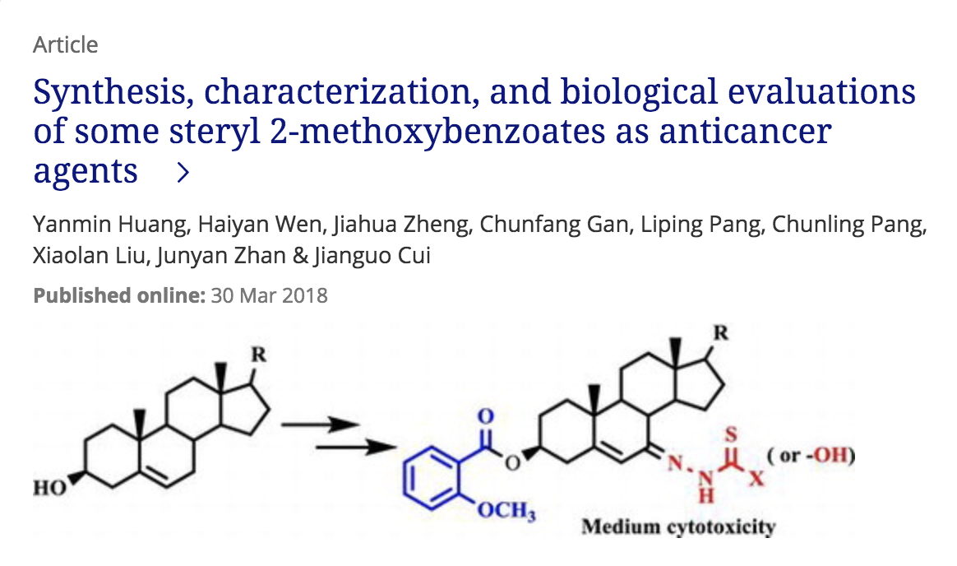
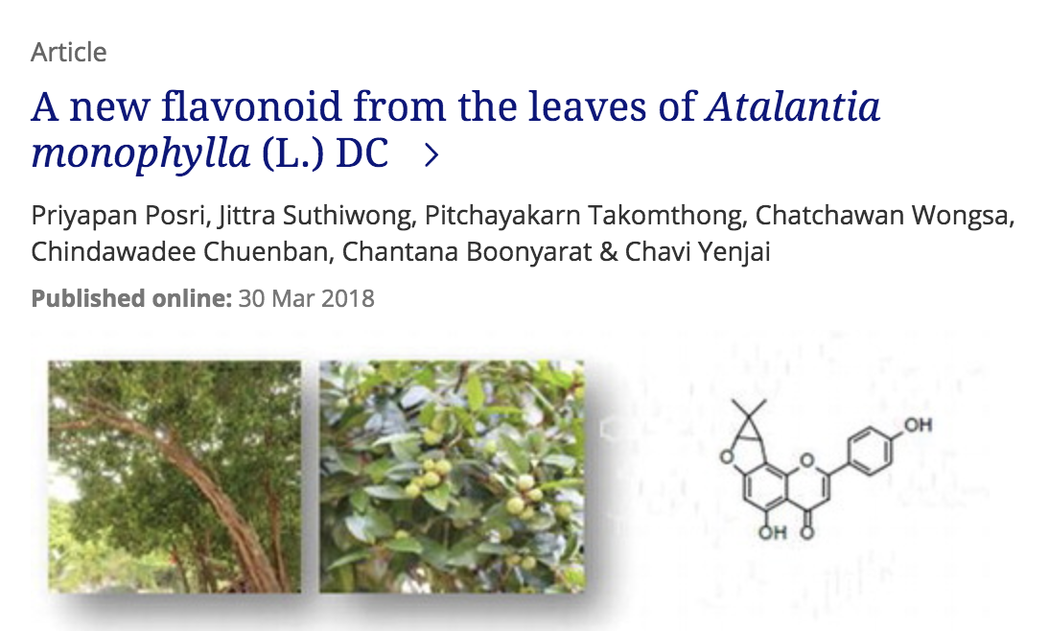
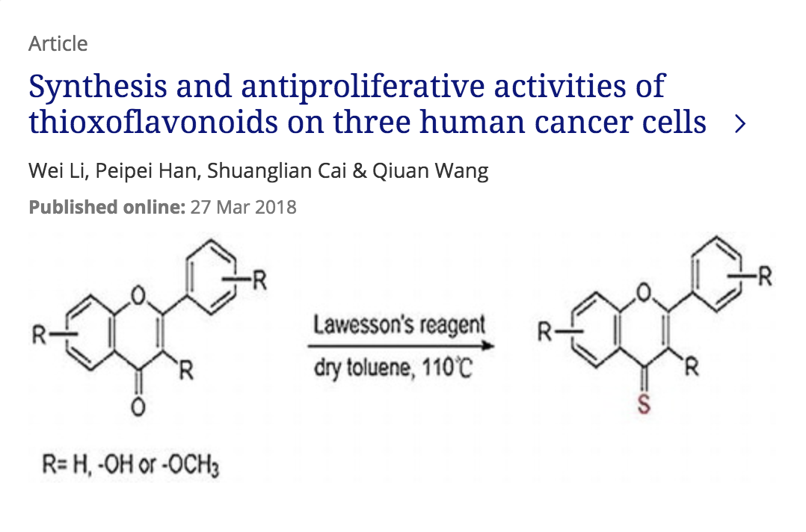
Natural Products Research is ongoing -and a lot of it is about structure discovery
Notes:
And, it seems, a very chinese pastime!

Slide 8
Current Natural Products Discovery is a Slow Process
Field Collection
Diving & Snorkeling
Samples for Extraction
Morphological Taxonomy
Microscopic Study
Phytologists
Crude Extracts
Samples for RNA later
Invasive Extraction
Organic Solvents
The Bottlenecks
Fractionation
Molecular Networking
Proton NMR
Purification
Recrystallization
Chromatography
Planar Structure Determination
HRMS
2D NMR
1st Round Bioassay
IR and UV
Our goal:
Speed up
structure determination after 2D NMR
Absolute Stereochemistry Elucidation
Circular Dichroism
Marfey’s Analysis
2nd Bioassays
IC₅₀
SAR Study
Drug Leads
Chiral Auxiliary NMR
Mechanism
Notes:
Stuff is collected from “the field”

Slide 9
Natural Products Research
Figuring out the structure of any new compound starts with the 2D NMR spectrum of the compound – the “fingerprint” of the compound
Using a deep, convolutional siamese neural network, we have developed a system called SMART that clusters compounds directly from their NMR spectrum.
This allows new compounds to be mapped into the cluster space, giving an idea of what compounds it is similar to.
This can speed up structure discovery

Slide 10
2D Nuclear Magnetic Resonance Imaging (2D NMR)
2D NMR is a technique that gives indications of bonds between atoms in a molecule
We think of it as the “fingerprint” of the molecule
And now I’ve told you everything I know about NMR!!
Notes:
I kept dreaming of a world I thought I’d never see. And then, one day, I got in!

Slide 11
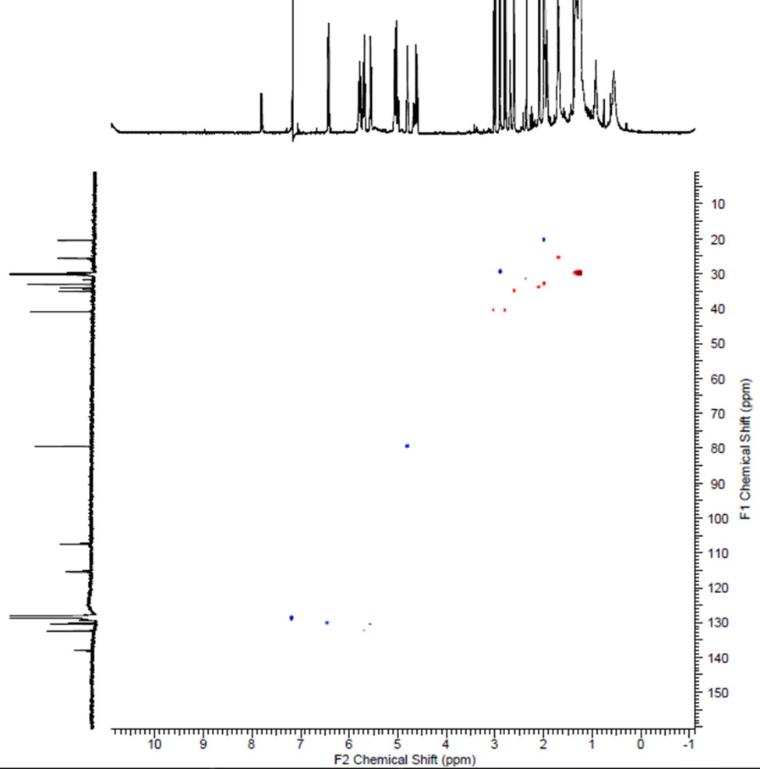
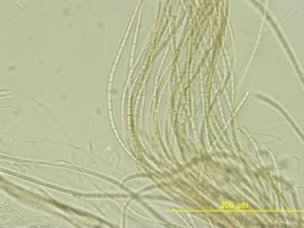
2D NMR is an Indicator of Compound Structure
HSQC 3.6mg, C₆D₆
Caldora penicillata
Each “dot” here corresponds to a bond
Notes:
Plus, C13 nmr take longer time than HSQC.
All information you need is there. And connectivity information is the “hidden features”.

Slide 12


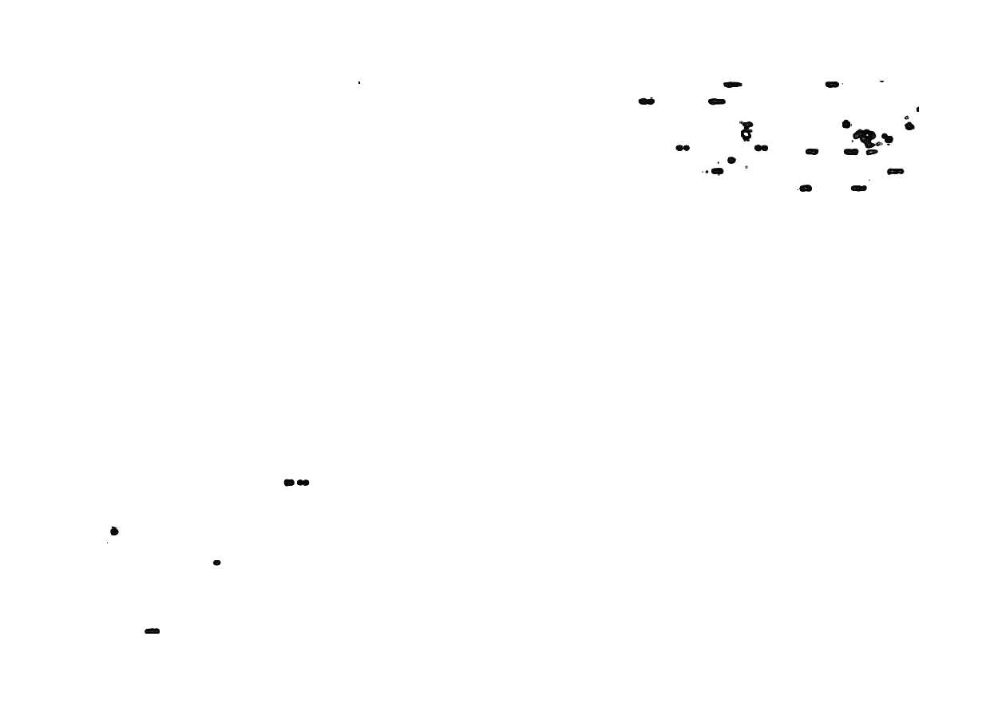
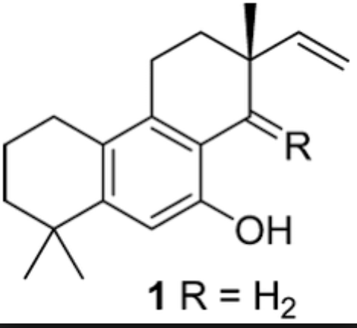
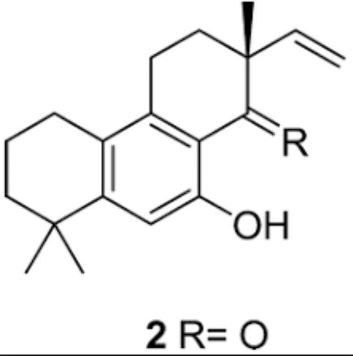
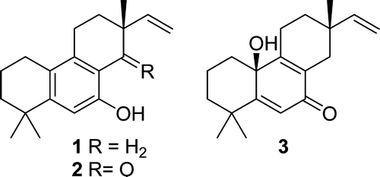
NMR structure analysis is subtle
Aspewentin A Aspewentin B Aspewentin C
NMR Spectrum
Actual Structure
Notes:
All of those little dots are data!

Slide 13
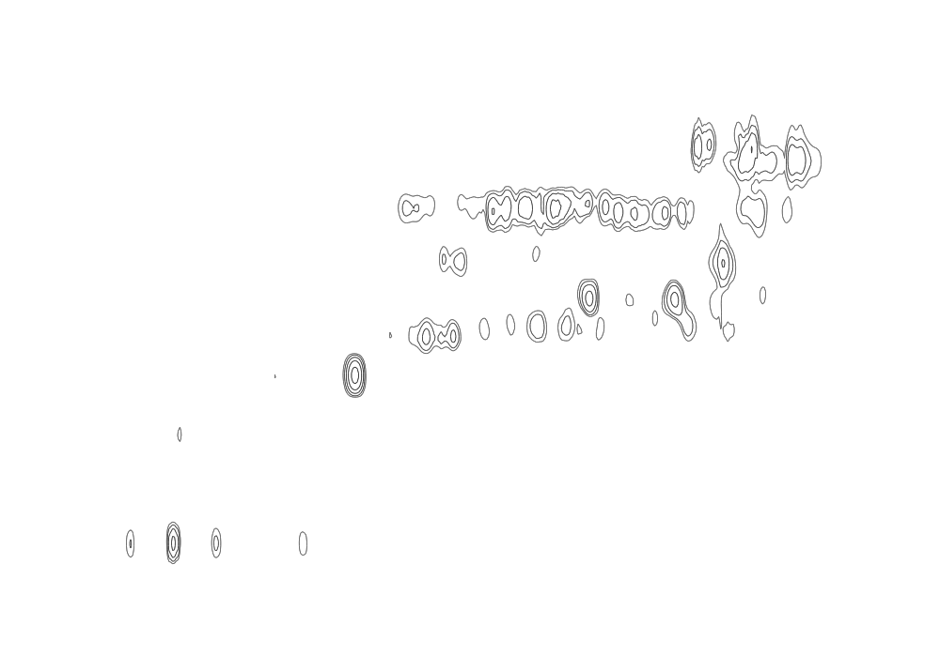
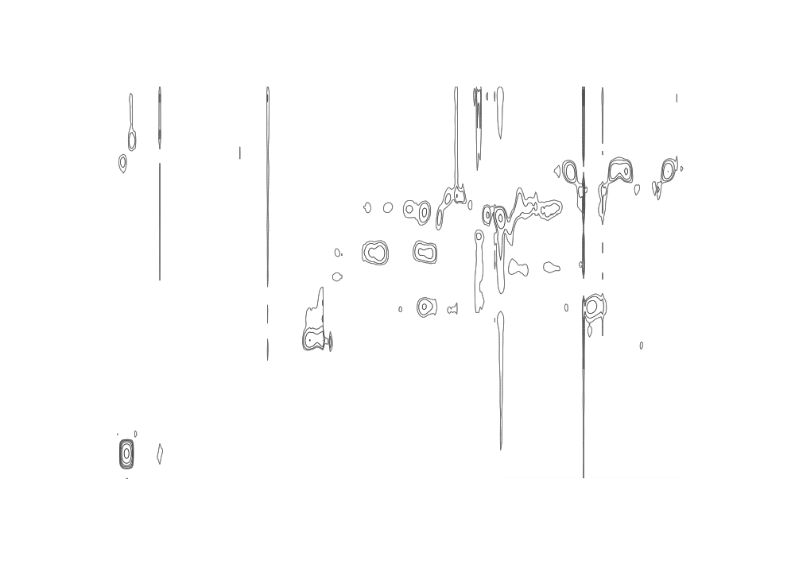
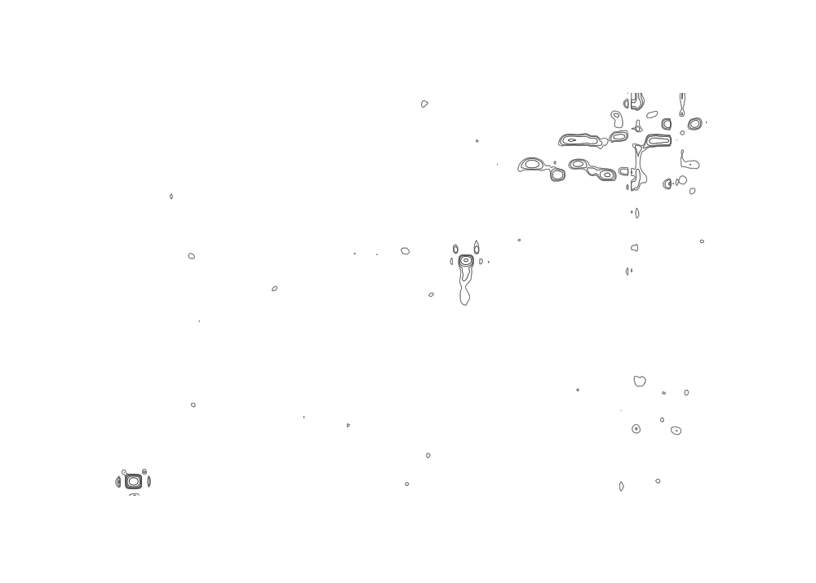
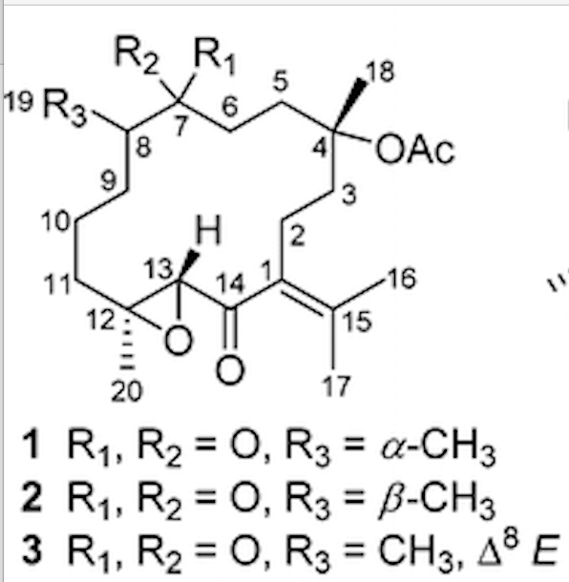
And Noisy!
Chandonanone A Chandonanone B Chandonanone C
NMR Spectrum
Actual Structure
These are artifacts of the solvent used...
Notes:
All of those little dots are data!

Slide 14
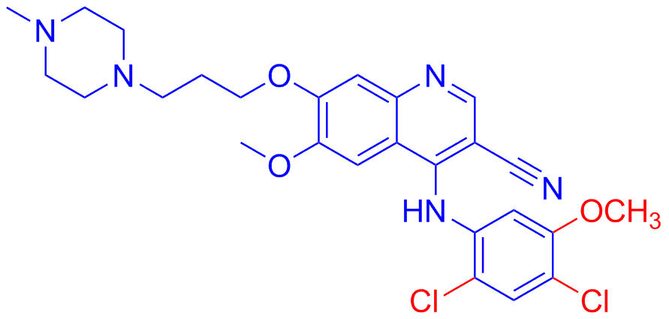
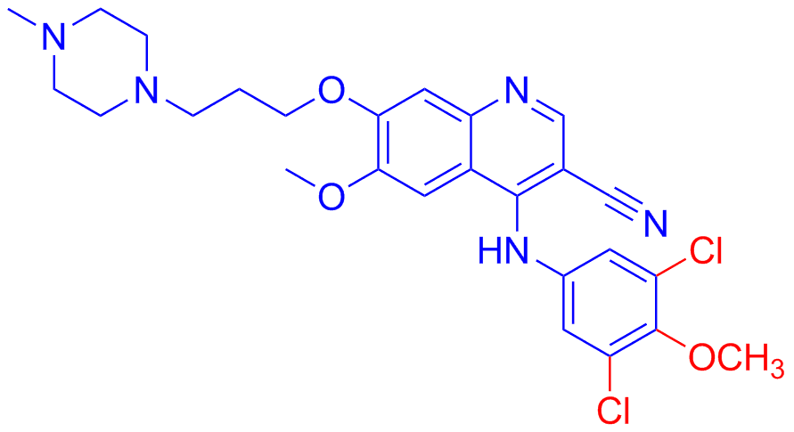
And Mistakes can be Costly...
Same Mass
Same Chemical Composition
Similar Chemical Structures
NMR Misinterpreted by Human
Very Different Biological Function!
Bosutinib
Anti-leukemia
“I still wonder what we could have done better. Clearly, not every lab can run and analyze an NMR spectrum of every chemical compound ordered.”
— Dr. Ulrich Schweizer,
Researcher at Charité-Universitätsmedizin Berlin, Germany
Bosutinib Isomer
“We had wasted a huge amount of time and money on the wrong isomer.”
— Dr. Steven G. Boxer,
Distinguished Professor of Chemistry at Stanford University
These small changes (in red), which cannot be detected by techniques such as mass spectrometry or elemental analysis, affect the biological activity of the compounds
Levinson, et al. PLOS ONE 2012, 7, (4), e29828
https://tinyurl.com/y9bhqxbt
Notes:
Here is an example about the challenge of NMR based spectral analysis

Slide 15
Enter Deep Learning
Deep learning:
Any neural network with more than one hidden layer – usually many more!
Convolutional Networks:
Have revolutionized computer vision since 2012
Learn many features
But apply the same feature across the image
Notes:
How to apply deep learning to learn the deep?

Slide 16
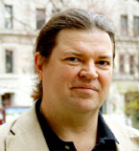
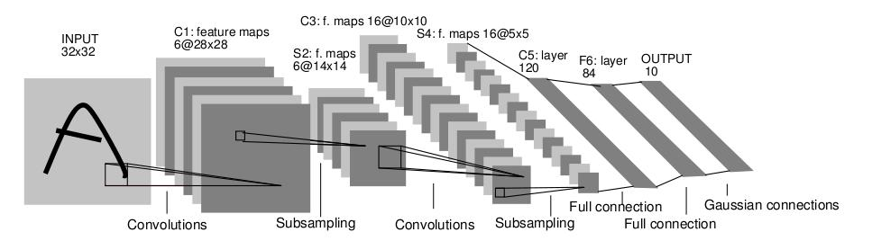
Convolutional Neural Networks
Began with LeCun et al. 1989
Small, local receptive fields and learned features (kernels): locality
These are replicated across the image: stationary statistics
Spatial pooling: translation invariance

Slide 17
Convolutional Networks -- What they’re good at: The Imagenet Large Scale Visual Recognition Challenge (ILSVRC)
1.2 Million training images
1000 categories (732-1300 training images per class)
50,000 test images
Large variation in images
Many fine-scale categories (120 dog breeds, not just “dog”)

Slide 18
Imagenet challenge goal: Classification
[Krizhevsky et al. NIPS 2012]

Slide 19
Why Deep Learning
2010 2011 2012 2013 2014 Human 2015 2016
Alexnet

Slide 20
Why Deep Learning
2010 2011 2012 2013 2014 Human 2015 2016
ZF Net:
Tuned Alexnet

Slide 21
Why Deep Learning
2010 2011 2012 2013 2014 Human 2015 2016
GoogLeNet:
AKA “Inception”

Slide 22

Why Deep Learning
2010 2011 2012 2013 2014 Human 2015 2016
Andrej Karpathy after three days of training!

Slide 23
Why Deep Learning
2010 2011 2012 2013 2014 Human 2015 2016
ResNet

Slide 24
Why Deep Learning
2010 2011 2012 2013 2014 Human 2015 2016
Inception-ResNet-v2

Slide 25
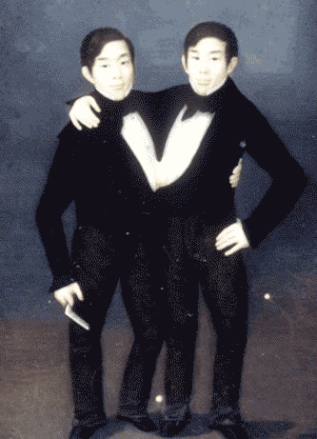
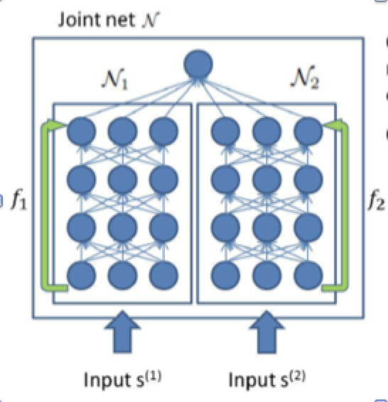
Siamese Neural Networks
“Siamese twins” is a dated term for Conjoined Twins - twins that are physically joined at birth, sometimes sharing organs
SNNs are the Neural Network analog for Conjoined Twins
SNNs have two identical neural networks (like twins that are physically joined at birth)
SNNs share their weights, both networks have the same weights (like twins sharing organs)
They take two inputs and share a symmetric loss function ( more about the loss function later )

Slide 26
Siamese Neural Networks
Siamese Networks can be convolutional..
They have linear output units, but they are not trained to any particular output – instead, they are trained to move outputs closer or farther apart.
If two inputs are from the same category, minimize the distance between them
If two inputs are from different categories, maximize the distance between them – up to some margin

Slide 27
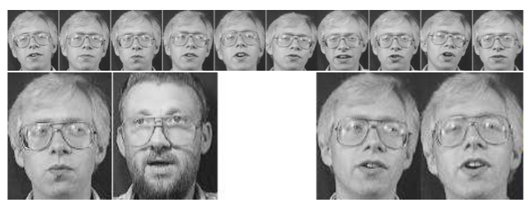
Same/Different Categories
Different: Same:
Move the output vectors apart Move the output vectors closer

Slide 28
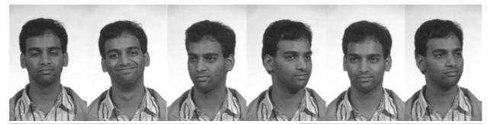
Same/Different Categories
Note that putting all of these into the same category means the network has to learn to be invariant to the differences in these images
This transformation should generalize to new faces

Slide 29
Siamese Neural Networks
Next: MNIST Example using two output units (so you can see what they do

Slide 30
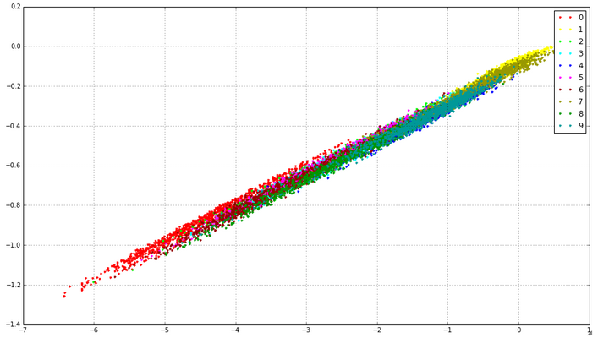
MNIST 100 iterations

Slide 31
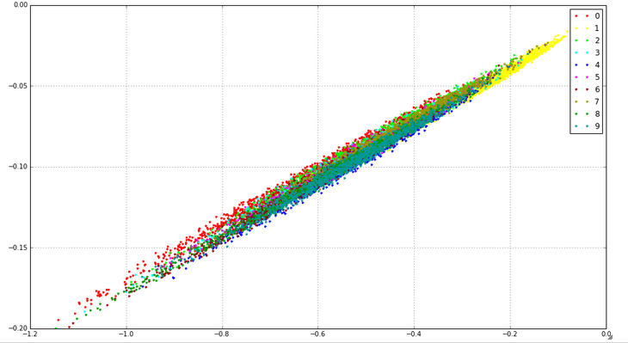
MNIST 200 iterations

Slide 32
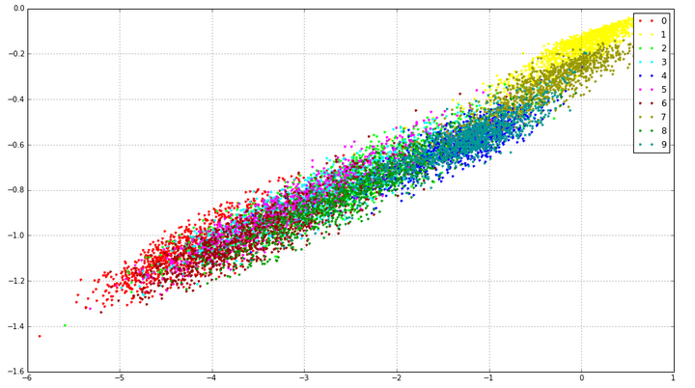
MNIST 300 iterations

Slide 33
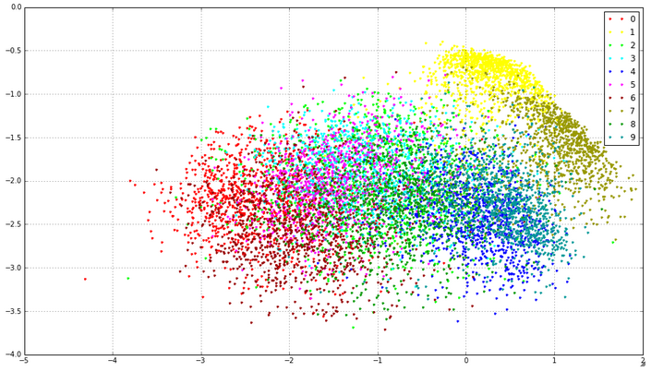
MNIST 400 iterations

Slide 34
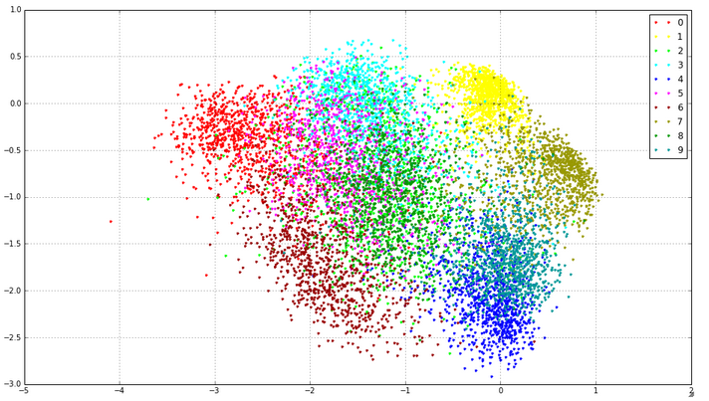
MNIST 500 iterations

Slide 35
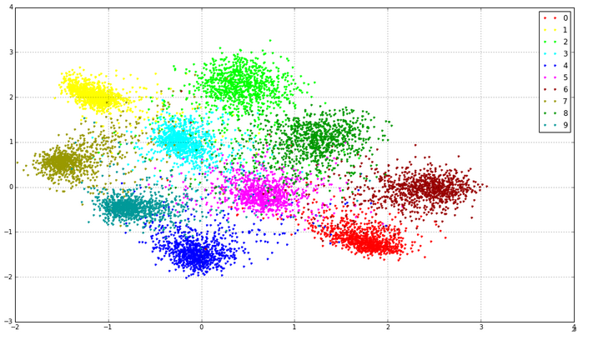
MNIST 5000 iterations

Slide 36
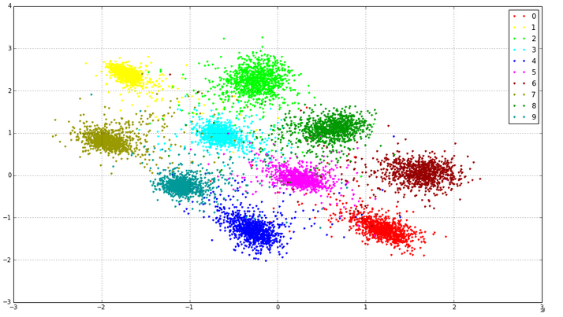
MNIST 50000 iterations

Slide 37
Advantages of Siamese Neural Networks
Because you train on pairs of data points, they amplify your training set
You don’t need to know the number of categories in advance
You don’t even have to have examples for all categories!
They are particularly suitable for domains where you have a large number of categories with a small number of examples

Slide 38
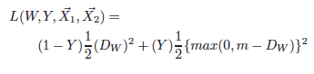
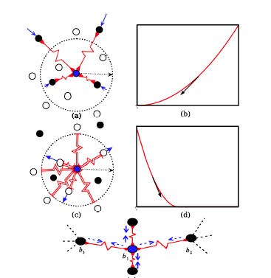
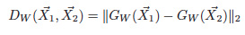
The loss function – The Spring Analogy
Where
D is the distance between the outputs of the two networks,
m is a margin
Y is 1 for a “different” pair and 0 for “same” pair
G_{W}(X) is the output vector of the network on stimulus X.

Slide 39
The basic idea
Aspewentin A Aspewentin C
“SAME”

Slide 40
The basic idea
“DIFFERENT”
Aspewentin A Chandonanone A

Slide 41
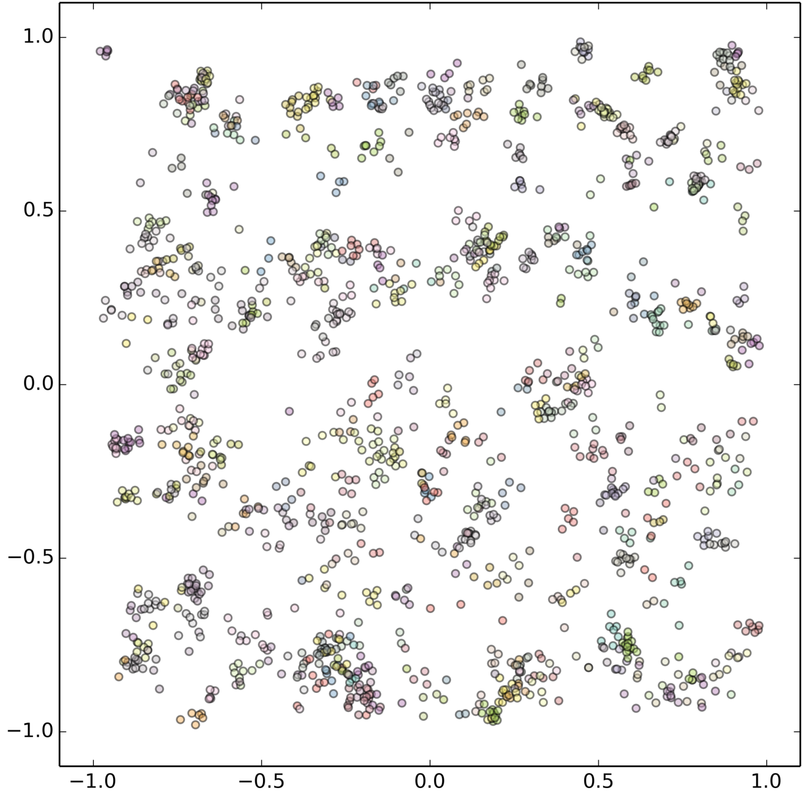
2054 spectra, 83,000 Iterations
Chen Zhang et al., Scientific Reports 2017

Slide 42
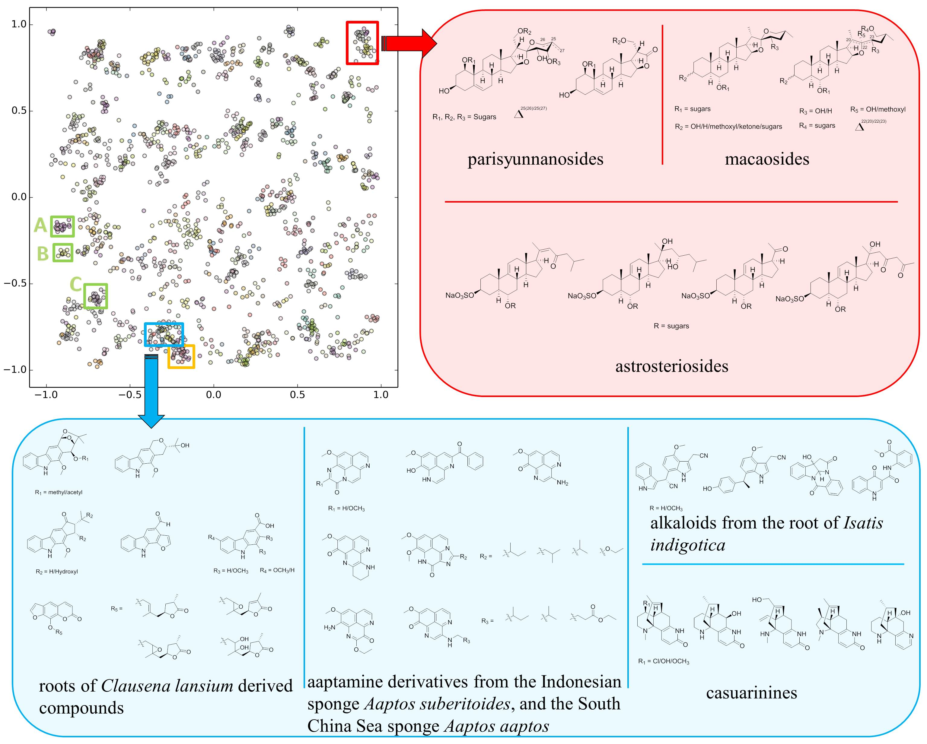
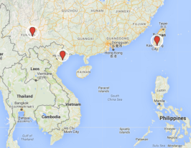
Qualitative Results
2054 spectra, 83,000 Iterations
Chen Zhang et al., Scientific Reports 2017
Notes:
Red box:
The parisyunnanosides were isolated from the rhizomes of the terrestrial plant Paris polyphylla Smith var. yunnanensis originating in Lijiang, Yunnan Province, China.
The macaosides were obtained from the aerial parts of the terrestrial plant Solanum macaonense collected in Kaohsiung, Taiwan.
The astrosteriosides were isolated from the marine starfish, Astropecten monacanthus found in Cat Ba, Haiphong, Vietnam.
--A small picture in the center of the red box shows the geographic distribution of those three subfamily of compounds
The parisyunnanosides have been reported to be toxic to leukaemia cells whereas the macaosides and astrosteriosides have been found to be anti-inflammatory.
Blue box:
A cluster consisting of 42 nodes is mainly poly-heterocyclic aromatic alkaloids. Within this cluster, there are four major molecular families , with the heterocyclic components being a pyrrole, imidazole, pyridine, or pyrazine, or a combination of these. Notably, several congeners of aaptamine, isolated from two varieties of Aaptos species collected in different geographic locations and reported in different issues of Journal of Natural products, are found in this cluster.
Orange box:
A cluster mainly consists of phenolic amides known as the teuvissides, which are anti-hyperglycaemic compounds isolated from Teucrium viscidum collected in Fujian Province, China.
Green boxes are discussed in the next slide.

Slide 43
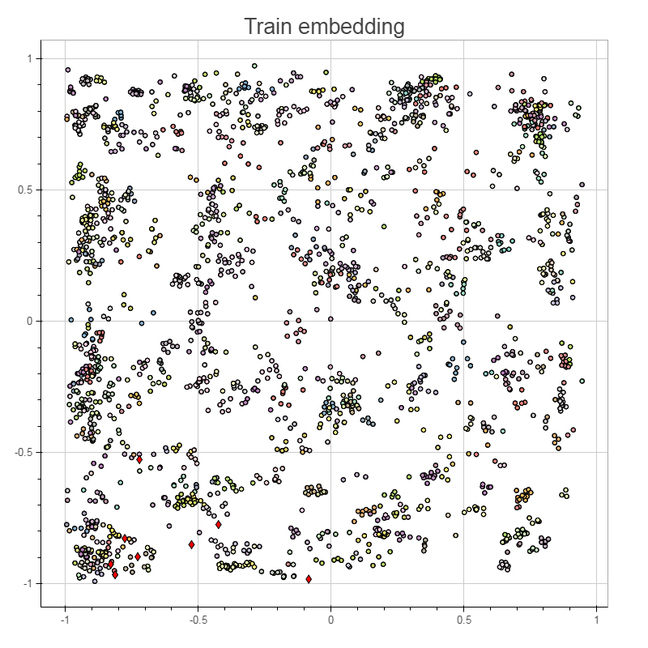
Red
Diamonds: Embedding of unknown 2D NMR
spectra into the Cluster
Map
Manuscript in prep, 2017
Notes:
The topmost red diamond is viequeamide A3, the right most diamond is viequeamide G, which was not included in the paper.

Slide 44
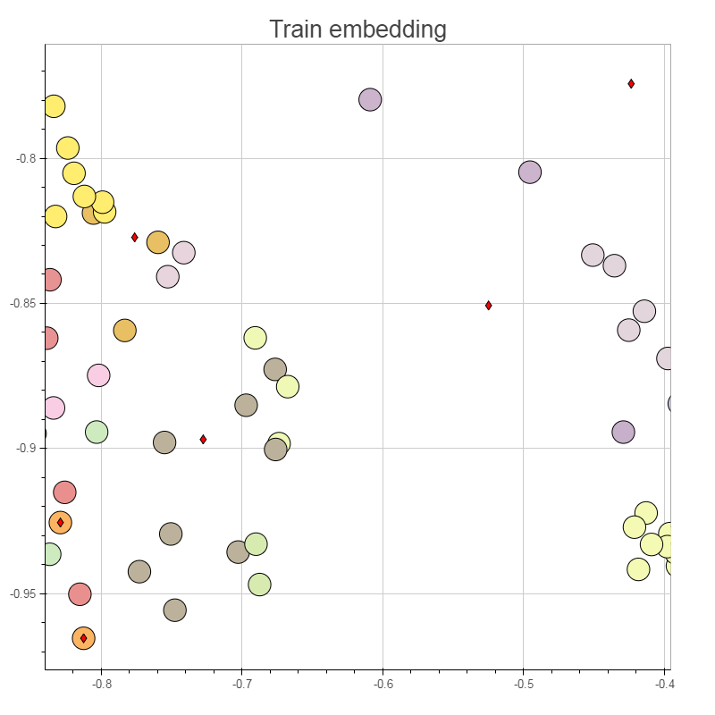
Enlargement of the local area of the embedding map
viequeamide A2
viequeamide B
viequeamide A
Manuscript in prep, 2017
Notes:
Two orange nodes to the lower left are viequeamides A and B in the training set. So newly isolated viequeamide A and B were dereplicated.
Label other nodes

Slide 45

More recent results: just 300 epochs!

Slide 46

Quantitative Results: 10D outputs
Precision
Recall

Slide 47
Demo
What you will see is the result of a network with 3 outputs
So, a 3D clustering

Slide 48

Chen Zhang et al., Scientific Reports 2017
Notes:
Compounds isolation based on spectroscopic guided or bioactivity guided method
2D HSQC data generation with NUS or conventional HSQC spectra
embedding those HSQC spectra into an AI clustering map, which was the results of the training of the SMART. The goal is to find closest structurally resembled compound family of the unknown compounds on the AI clustering map.
After dereplication and determination of the structure, we have molecular structures output.

Slide 49
Enlargement of the local area of the embedding map
viequeamide A2
viequeamide D
viequeamide C
viequeamide B
viequeamide A
Manuscript in prep, 2017
Notes:
Two orange nodes to the lower left are viequeamides A and B in the training set.

Slide 50






Conclusions and Future Work
Coming Soon
A lot of inquiries and requests from researchers worldwide
Pharmaceuticals
Perfume and cosmetics
Agricultural chemistry
Environmental sciences
NMR industries
Soon: A user-friendly website with enhanced data security features

Slide 51
Future Work
These results are using a “legacy” neural network – not optimized for the problem
Better network architecture
Using an autoencoding layer is supposed to improve results (Yann LeCun – personal communication)
We are working on a new network objective function based on “purity” – a measure of cluster purity
Purity is non-differentiable
We have created a “soft”, differentiable version

Slide 52

Acknowledgements
GURU members:
The NMR:
Dr. Brendan Duggan
Dr. Anthony Mrse
Dr. Eugene Lin
Physics:
Dr. Preston Landon
Dr. Jie Min
Yash Nannapaneni
Nick Roberts
Poornav Sargur Purushothama
The Gerwick Lab
Yerlan Idelbayev
UC Merced
Notes:
Presenting at ACD's workshop would definitely enlarge the audience and increase the awareness on the technology.
In concluding remarks of your presentation there I would suggest throwing something like "... we are really excited about SMART technology and all the different applications it might be used for. We are looking forward to talking with industry partners to maximize its use across different market segments..."
We don't want attendees to think we are tied in with ACD labs. But the message to ACD labs is that SMART technology fits really well with their product offering and we are open to consider various ways to partner with them (and our licensing team would get involved).

Slide 53
Acknowledgements
GURU members:
The NMR:
Dr. Brendan Duggan
Dr. Anthony Mrse
Dr. Eugene Lin
Physics:
Dr. Preston Landon
Dr. Jie Min
Yash Nannapaneni
Nick Roberts
Poornav Sargur Purushothama
The Gerwick Lab
Yerlan Idelbayev
UC Merced
Bill Gerwick
Scripps Instution
of Oceanography
Chen Zhang
Scripps Instution
of Oceanography
Notes:
Presenting at ACD's workshop would definitely enlarge the audience and increase the awareness on the technology.
In concluding remarks of your presentation there I would suggest throwing something like "... we are really excited about SMART technology and all the different applications it might be used for. We are looking forward to talking with industry partners to maximize its use across different market segments..."
We don't want attendees to think we are tied in with ACD labs. But the message to ACD labs is that SMART technology fits really well with their product offering and we are open to consider various ways to partner with them (and our licensing team would get involved).

Slide 54





Acknowledgements:
Funders
Notes:
Presenting at ACD's workshop would definitely enlarge the audience and increase the awareness on the technology.
In concluding remarks of your presentation there I would suggest throwing something like "... we are really excited about SMART technology and all the different applications it might be used for. We are looking forward to talking with industry partners to maximize its use across different market segments..."
We don't want attendees to think we are tied in with ACD labs. But the message to ACD labs is that SMART technology fits really well with their product offering and we are open to consider various ways to partner with them (and our licensing team would get involved).

Slide 55
Questions?

